Slide 1
Fair Energy Consumption in Wireless Sensor Networks
Niels Kasch* | Dave Feltenberger* | Fatih Senel*
nkasch1@umbc.edu | dfelten1@umbc.edu | fsenel1@umbc.edu
*Department of Computer Science and Electrical Engineering
University of Maryland, Baltimore County
Baltimore, MD 21250
4/12/2009

Slide 2
Outline
Introduction to Wireless Sensor Networks (WSNs)
Problem Statement
  notion of Fairness
Steiner Minimum Tree (3-approximation)
Our algorithm
Experimental results
Demonstration

Slide 3
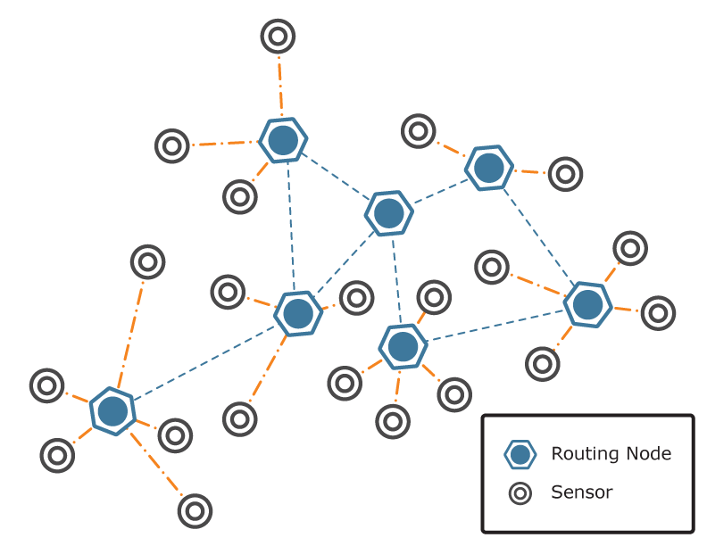
Introduction
Wireless Sensor Network (WSN)
    collection of independent
    devices (nodes)
    connected wirelessly
    Sensor Nodes
      are equipped with sensors
      collecting environment data
      active and passive sensors
    Relay nodes
      Relay information
      Provide connectivity

Slide 4


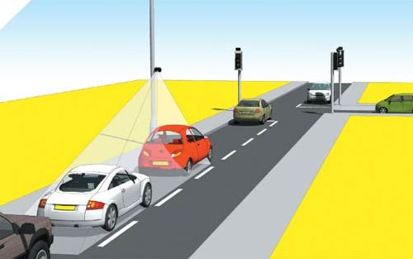
Application Areas and Issues
Monitoring
  Traffic
  Geologic
Biomedication
Battery powered nodes
  Reasons:
    Location
    Economical
    Political
Considerations/Impact:
  Battery lifetime
  Connectivity
  Time to node failures
  Network disconnects

Slide 5
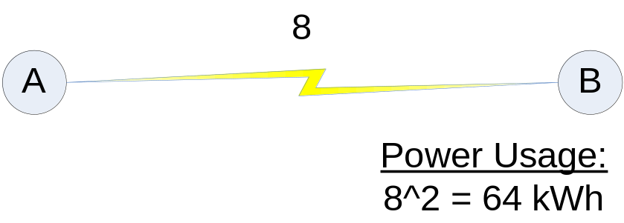
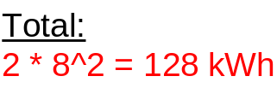
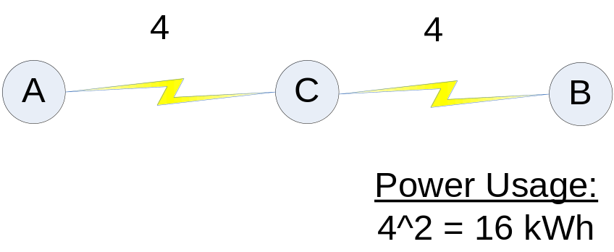
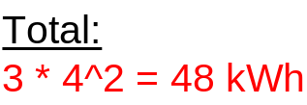
Issues with WSNs
Transmission range
  Limited
  Energy Efficiency
    transmissions drop off at exponential rate
    E = d^2
Fair power consumption
  Predictability of node failure
  Optimize replacement schedules
    all nodes fail simultaneously
    groups of nodes fail simultaneously
    nodes fail in a predetermined order

Slide 6
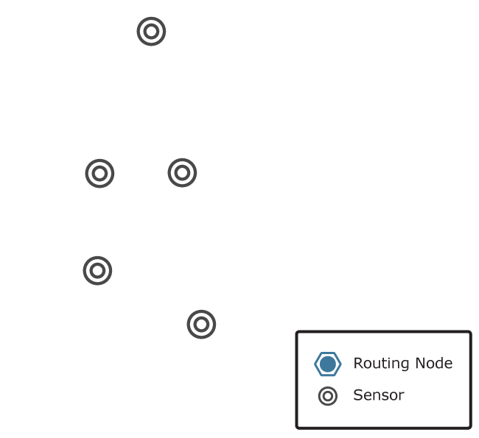
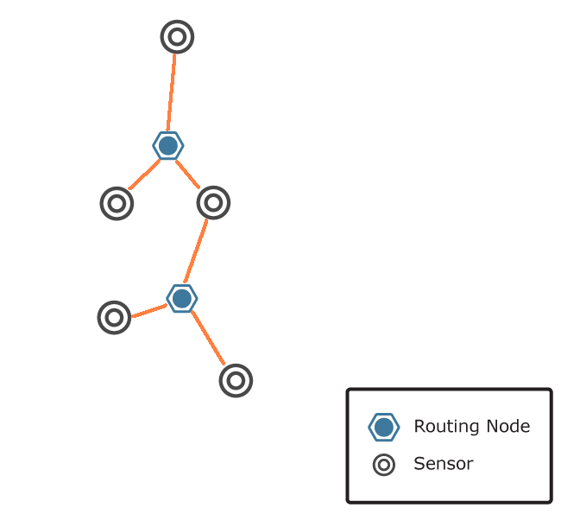
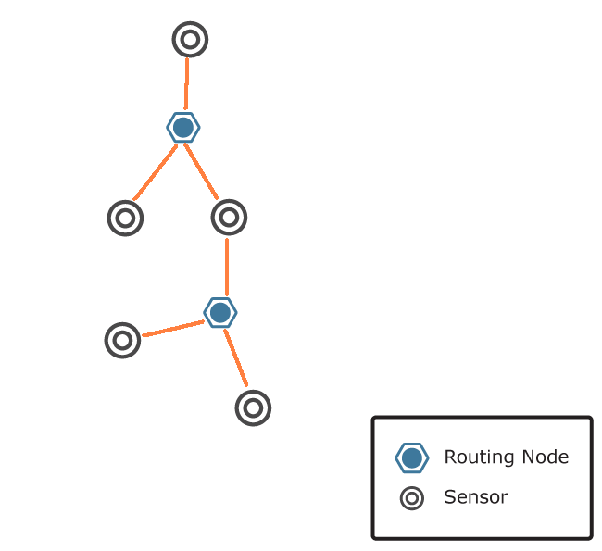
Problem Statement
Connect a WSN – possibly using Relay nodes
Fairness in Power Consumption
  Power Consumption Rates (PCR)
    Standard deviation
  Equalize PCR
  Introduce additional Relay nodes
Minimal Fair Energy Consumption with Minimal Additional Resources (MFEC-MAR)
Minimal Fair Energy Consumption with Minimal Additional Resources Approximation (MFEC-MAR-Approx)
  Input: A set of fixed sensor nodes S in Euclidean space, a standard deviation α of power consumption rates and a maximum number of relay nodes k.
  Output: A connected network
    G = ({S,R},E) such that:
      R is the set of introduced relay nodes such that R <=k
      PCR’s are equal
      G is connected

Slide 7
Steiner Minimum Tree – with minimum number of Steiner points
SMT-MSP is NP-Complete.
Ratio-3 approximation is used.
  Connect 2 terminal a, b if the distance is less than R.
  Form 3-stars
  Steinerize the resulting topology
  Time-Complexity is O(n³)

Slide 8
Fair Power Consumption – An Algorithm
General Idea
  Ratio-3-SMT
  MakeFair(G, α, k)
MakeFair
  MoveRelayNode-geometric
  AddRelayNode
  MoveRelayNodes

Slide 9
Form 3-Stars & Steinerize
Put a 3-star, if there exists a point s within distance R from a, b and c, where a, b and c are in different connected components
b
a
s₁
c
s₂
d
s₃
Steinerize resulting connected components, by filling the shortest gap between two different connected component

Slide 10
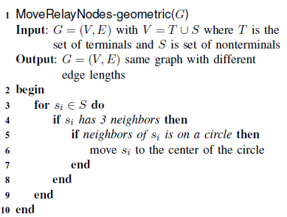
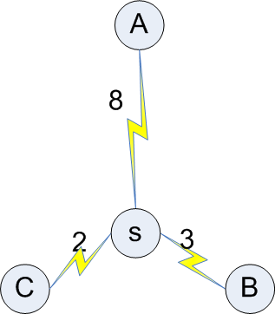
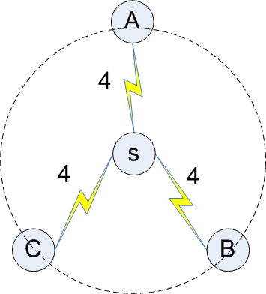
MoveRelayNode-geometric

Slide 11
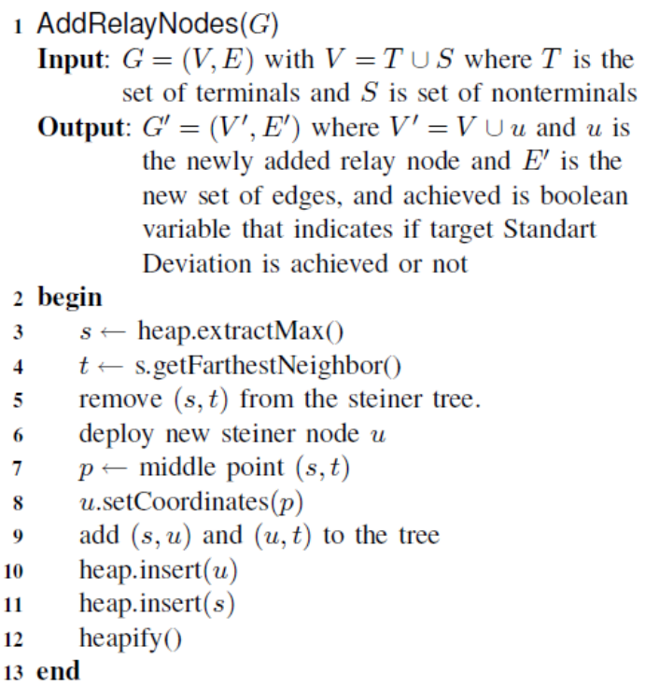
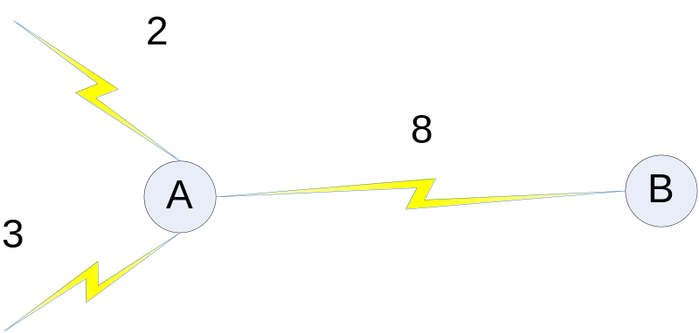
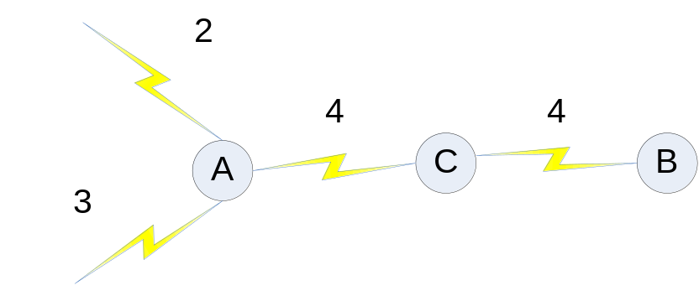
AddRelayNode
Heap Datastructure
  Greedy choice
  Split the greatest distance first (max power consumption)

Slide 12
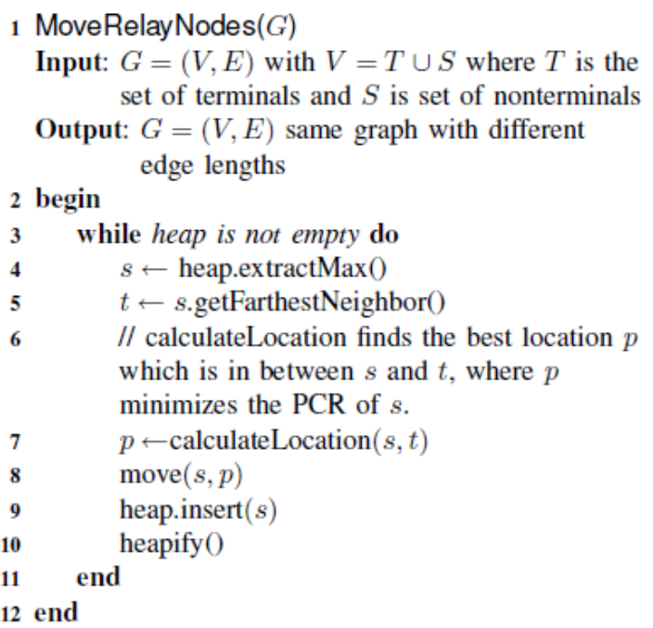
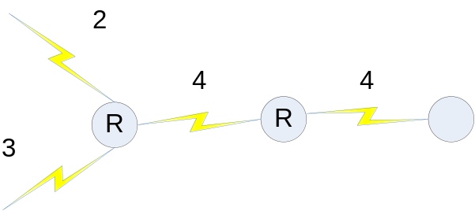
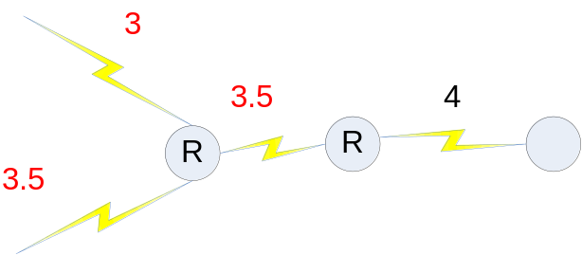
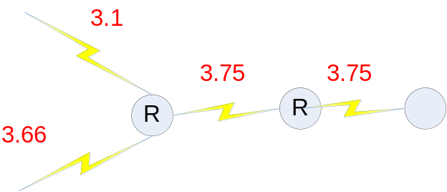
MoveRelayNodes
moving (calculateLocation)
  iterative process
  approaches the best location
  by “walking” and testing PCR

Slide 13
Experimental Results
Maximizing fairness is hard!
  With certain topologies, impossible to be perfect
  particularly with large surface area
Couldn’t compare against other base lines
  Could not find papers discussing fairness
Tests on varying canvas sizes
  100x100 to 600x600
  K from 1 to 20

Slide 14
Experimental Results
Fairness
  as number of relay nodes increases, fairness increases
    more opportunities to minimize the difference in distances.
  Fairness is significantly different for large canvas sizes
Power Consumption
  Increases as surface area increases
  Decreases with more relay nodes
Optimal k value
  Depends on canvas size!
    Need fewer relay nodes with small canvas
    More with large canvas

Slide 15
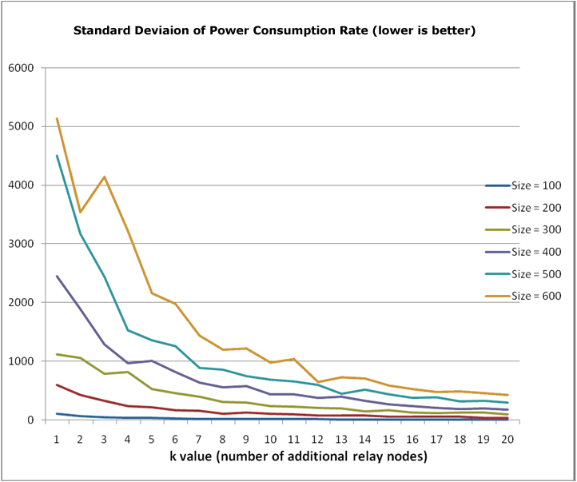
10 terminal nodes
Std Dev of Power Consumption

Slide 16
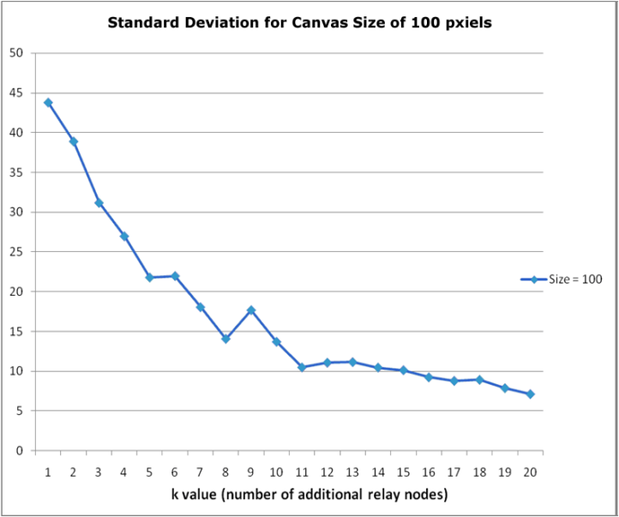
Std Dev of Power Consumption

Slide 17
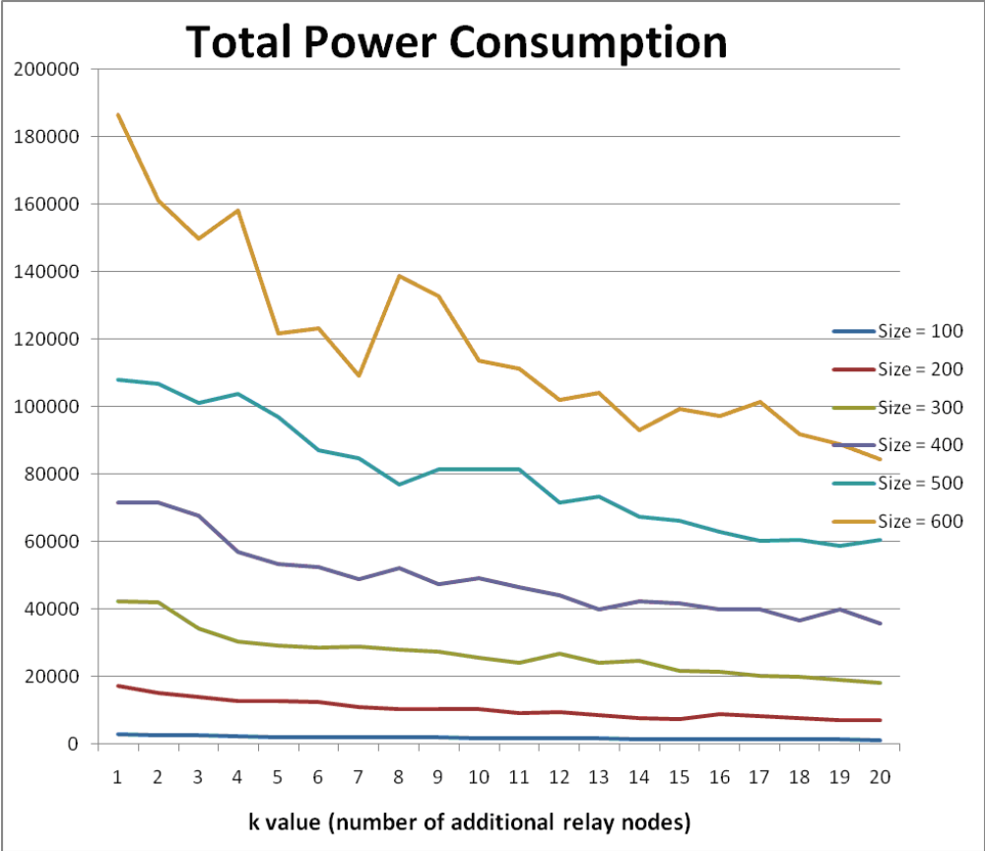
Power Consumption

Slide 18
Simulation
Written in Java
Found SMT implementation online
Modified SMT to include maximize fairness
Show demonstration…

Slide 19
Conclusion
Fairness in power consumption
    failures occur approximately at the same time
Comparison to other methods
  no baseline comparisons in literature
  the context of the application changes characteristics
      Larger surface areas require more relay nodes
      more relay nodes are needed to achieve fairness when number of terminal nodes is low reducing overall power consumption
reducing overall power consumption
two-fold optimization of optimizing fairness and power consumption
connecting all nodes within range
  include them in fairness and power measurements.

Slide 20
Questions?

Slide 21
References
Estrin D. and Girod L. and Pottie G. and Srivastava M., (2001) Instrumenting the world with wireless sensor networks, Acoustics Speech and Signal Processing 2001. Proceedings. (ICASSP 01). 2001 IEEE International Conference on
Cheng Xiuzhen and Du Ding-Zhu and Wang Lusheng and Xu Baogang, (2008) Relay sensor placement in wireless sensor networks, Wirel. Netw.
Lloyd Errol L., (2007) Relay Node Placement in Wireless Sensor Networks, IEEE Trans. Comput.
Chen Donghui and Du Ding-Zhu and Hu Xiao-Dong and Lin Guo-Hui and Wang Lusheng and Xue Guoliang, (2000) Approximations for Steiner Trees with Minimum Number of Steiner Points, J. of Global Optimization
Gandham S.R. and Dawande M. and Prakash R. and Venkatesan S., (2003) Energy efficient schemes for wireless sensor networks with multiple mobile base stations, Globecom
Q. Gao and K.J. Blow and D.J. Holding and I.W. Marshall and X.H. Peng, (2006) Radio range adjustment for energy efficient wireless sensor networks, Ad Hoc Networks
Chao Song and Ming Liu and Jiannong Cao and Yuan Zheng and Haigang Gong and Guihai Chen, (2009) Maximizing network lifetime based on transmission range adjustment in wireless sensor networks, Computer Communications
Jian Tang and Bin Hao and Arunabha Sen, (2006) Relay node placement in large scale wireless sensor networks, Computer Communications
Bao Nguyen Nguyen and Deokjai Choi, (2007) Fair Energy Consumption Protocol with Two Base Stations for Wireless Sensor Networks, Network and Parallel Computing Workshops 2007. NPC Workshops. IFIP International Conference on
Cormen Thomas H. and Stein Clifford and Rivest Ronald L. and Leiserson Charles E., (2001) Introduction to Algorithms
Heinzelman Wendi Rabiner and Chandrakasan Anantha and Balakrishnan Hari, (2000) Energy-Efficient Communication Protocol for Wireless Microsensor Networks
Lin Guo-Hui and Xue Guoliang, (1999) Steiner tree problem with minimum number of Steiner points and bounded edge-length, Inf. Process. Lett.
Chen Donghui and Du Ding-Zhu and Hu Xiao-Dong and Lin Guo-Hui and Wang Lusheng and Xue Guoliang, (2000) Approximations for Steiner Trees with Minimum Number of Steiner Points, J. of Global Optimization

